Slide 1
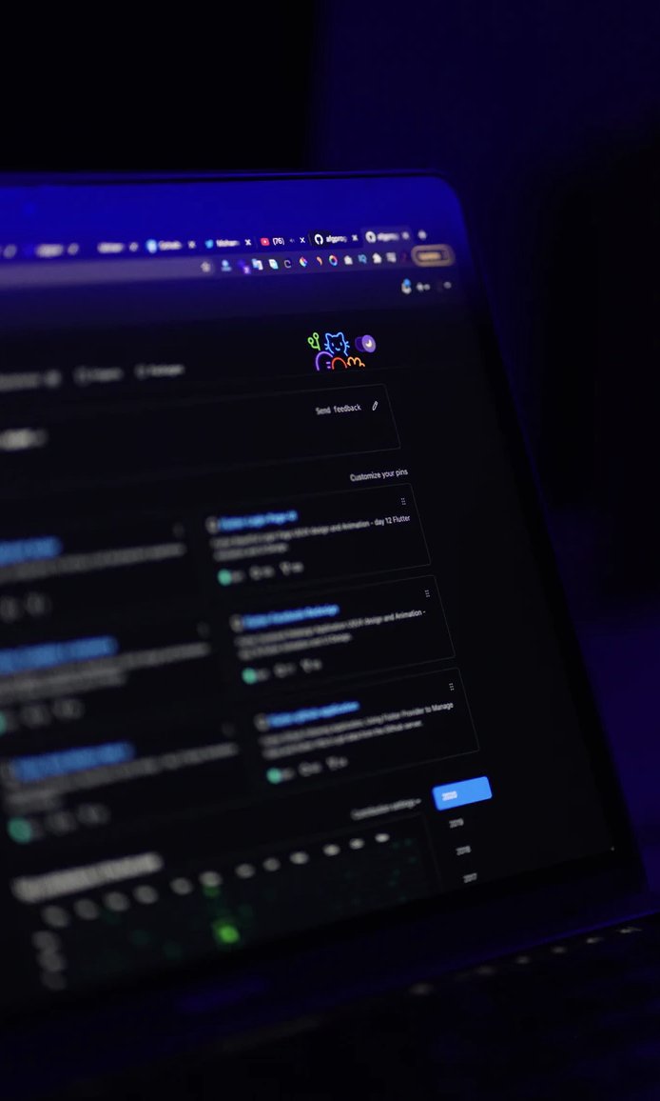

Text-Mining: Introduction and Theory
Nadia Kennar,
Research Associate at Cathie Marsh Institute and UK Data Service
nadia.kennar@Manchester.ac.uk
@NadiaKennar
Copyright © 2022 University of Manchester, Cathie Marshe Institute, UK Data Service
.

Slide 2
Can you hear us?
?

Slide 3
Can you hear us?
If not:
Check your speaker/headset is plugged in / volume is on.
Click on audio to change to listening via phone
We are recording this webinar and will post it on YouTube (https://www.youtube.com/user/UKDATASERVICE)
Copyright © 2022 University of Manchester, Cathie Marshe Institute, UK Data Service
.

Slide 4
You might also be interested in...
Recent -
Mapping Crime Data in R: An Introduction to GIS and spatial data
Introduction to Machine Learning
Code Demos
https://www.ukdataservice.ac.uk/news-and-events/events/past-events.aspx
https://www.youtube.com/user/UKDATASERVICE
Upcoming -
Text-mining: Code demo (Python and R) 11th November
How to become a computational social scientist – 22/11/2022
Crime Surveys User Conference 7th December
Computational social science drop-in 13th December

Slide 5
Content
9th November:
Hour 1:
Introduction to its main concepts
Capturing and amplifying existing structure
Structured vs unstructured
Text-Mining in 4 Steps
Hour 2:
Steps in text-mining analysis
Processing methods
Basic NLP
Extraction
11th November:
Hour 1: Python tutorial
Pre-processing
Processing
Hour 2: R tutorial
Pre-processing
Processing

Slide 6

Text-mining is a form of data-mining

Slide 7
What do I mean by structured data?
Intro to Machine Learning
24/10/22
75 attended

Slide 8
What do I mean by structured data?
Intro to ML: p1
24/10/22
75
Intro to ML:
p2
26/10/22
72
Intro to ML:
p3
01/11/22
85

Slide 9
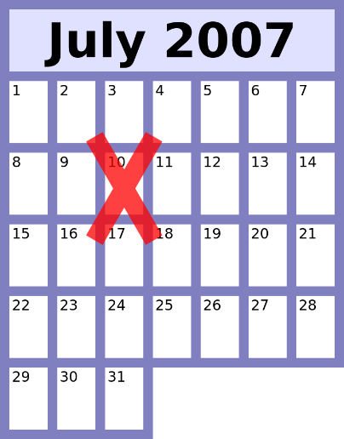
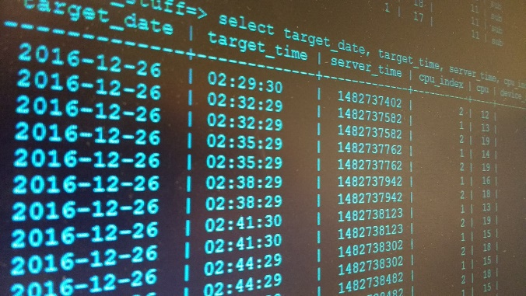
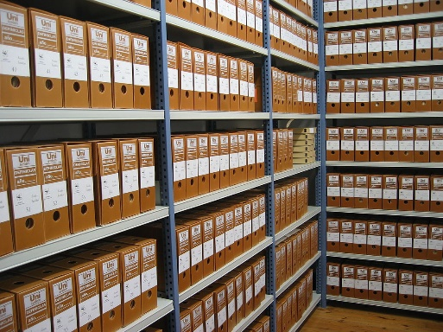




Think about commonly found examples of structured data?

Slide 10

Structured data is…
Intro to ML: p1
24/10/22
75
D
Intro to ML:
p2
26/10/22
72
Intro to ML:
p3
01/11/22
85
Familiar
Easy
Demonstrable

Slide 11

What about unstructured data?
Seventy- two
Intro to ML: p1
02/06/20
75 attended
Intro to ML #2
June 16
2020-06-29
80 - 90

Slide 12

What about semi-unstructured data?
Seventy- two
Intro to ML: P2 02/06/20
75 attended
Intro to ML #2
June 16
2020-06-29
80 - 90

Slide 13

Semi-(un)structured data is …
… less accessible
… difficult
… requires intuition and “common sense”
Seventy- two
Intro to ML P2. 02/06/20
75 attended
Intro to
ML #2
June 16
2020-06-29
80 - 90

Slide 14



Yeah… and?

Slide 15
Why can’t you just treat semi-structured and structured data the same?
The tools won’t work.
Forcing the tools to “sort of” work can be a real pain and waste of time!
Documenting the process is very difficult which makes for
Poor replicability
Hard to understand methods
Hard to visualise results
First, you need to turn semi-structured data into structured data.
There are tools to help you do that.

Slide 16
What are those tools?
Semi-structured data
Structured data

Slide 17

Text-mining in four steps
Retrieval
Processing
Extraction
Analysis
SEARCH Source = Twitter
Date = 01/01/2019 to 31/12/2022
Keywords = “negative” AND “fatigue” AND
“north” AND “England” AND “lockdown”

Slide 18

Text-mining in four steps
Retrieval
Processing
Extraction
Analysis
Raw data - - - > 1 file/row/database entry per tweet/document/webpage
Basic NLP – correct spelling,
remove capitalisation,
substitute acronyms or alternate references
More NLP – classify words by grammatical category,
disambiguate meaning by context,
parse sentences and mark up structure

Slide 19
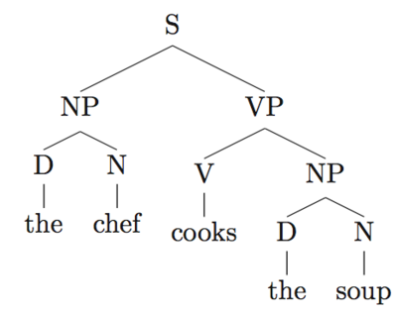
Text-mining in four steps
“The chef cooks teh soup”.
Retrieval
Processing
Extraction
Analysis
[S: [NP: [D: the] [N:chef]] [VP: [V: cook (singular, present) [NP: [D: the] [N:soup]]]]

Slide 20

Text-mining in four steps
Retrieval
Processing
Extraction
Analysis
(Relative) word counts
Equivalency suggestions
Relationship discovery
Automatic categorisation
Prediction

Slide 21

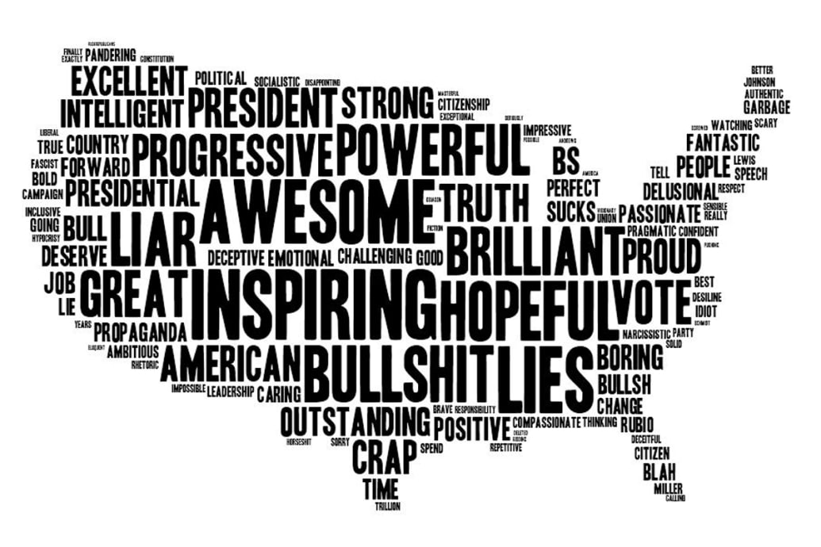
Text-mining in four steps
Retrieval
Processing
Extraction
Insight

Slide 22
Text-mining – One simple example
Retrieval Download 10 days of tweets from 20 users.
Download trending hashtags for those same 10 days
2. Processing Remove everything that isn’t a hashtag (punctuation, trailing whitespace)
Store individual hashtags in data frame labelled by date and author
3. Extraction Compare tweeted hashtags to trending list – by time, by volume, etc.
Calculate a “trendiness score” for authors based on degree of match and timing
4. Insight Explain what a trendiness score measures –
Influencer status? Finger-on-the-pulse-ness?
Tendency to jump on bandwagons? Something else?

Slide 23
Text-mining – A more complex example (“Semantic relations for problem-oriented medical records, Uzuner et al 2010”)
Retrieval Downloaded two sets of medical discharge summaries
Processing. Discharge summaries -> sentences -> tokens -> process that match verbs, structures and relationship (surface, lexical, and syntactic features)
Extraction. Compared tokens from within-sentences and tokens in concept to identify the relationship between problem- oriented records
4. Insight These results are promising for semantic indexing of medical records. They imply that we can take advantage of lexical patterns in discharge summaries for relation classification at a sentence level

Slide 24
Text-mining Pros and Cons
Pros:
Large scale approach to difficult stuff
Can see detail of sub-groups
Novel application
Cons:
Needs a large corpus
May need a lot of manually created training data
Lack of human interaction or supervision
Unclear what questions it can/cannot address
Lops off a bunch of structure or information that is hard to capture/amplify

Slide 25

Text-mining can’t (yet) provide expert level insight

Slide 26
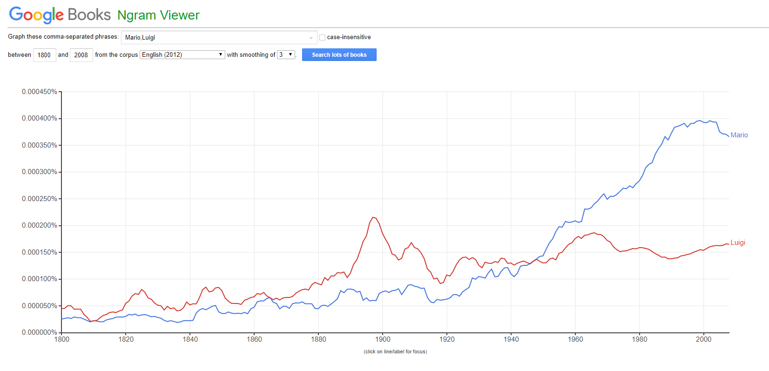
But it text-mining does…

Slide 27
Citations and recommendations
Cited academic paper
Predicting the Present with Google Trends. Choi and Varian, 2012.
https://doi.org/10.1111/j.1475-4932.2012.00809.x
- Semantic relations for problem-oriented medical records. https://www.ncbi.nlm.nih.gov/pmc/articles/PMC2948592/
Recommendations for Python
Programming with Python for Social Scientists. Brooker, 2020.
https://study.sagepub.com/brooker
Automate the Boring Stuff with Python: Practical Programming for Total Beginners, Sweigart, 2019. ISBN-13: 9781593279929
SentDex, python programming tutorials on YouTube https://www.youtube.com/user/sentdex
Recommendations for R
Quanteda, an R package for text analysis https://quanteda.io/
Text Mining with R, a free online book https://www.tidytextmining.com/

Slide 28
Material for Tuesday the 1st of November
GitHub:
https://github.com/UKDataServiceOpen/Text-Mining-Health

Slide 29

Nadia.kennar @manchester.ac.uk
Louise.capener@manchester.ac.uk
Julia.kasmire@manchester.ac.uk
@NadiaKennar
@CapenerLouise
@JKasmireComplex
@UKDataService
Thank You!

